Slide 1

How to Really use perplexity ai

Slide 2
What is covered
What is Perplexity AI?
Getting Started
A Tour of the Environment
Quick Search (Free)
The Importance of Good Prompts
Understanding Threads
Understanding Collections
Using Focus
Working with Attachments
Pro Search (Paid)
Pro Features (Paid)

Slide 3
Using focus

Slide 4
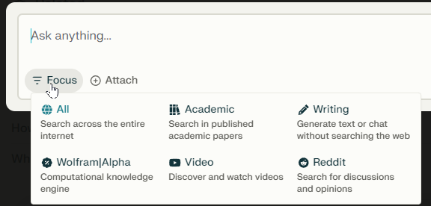

Slide 5
Working with attachments

Slide 6
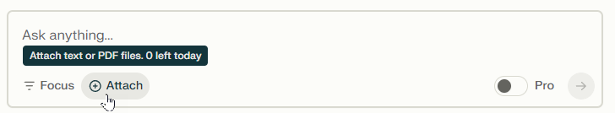

Slide 7




Notes:
https://www.youtube.com/channel/UC35ZpwldGw7ZJ5R-2sLijzw

Slide 8
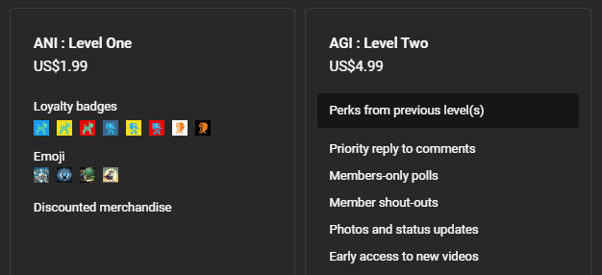

Membership has its privileges
Notes:
https://www.youtube.com/channel/UC35ZpwldGw7ZJ5R-2sLijzw/join

Slide 9

https://www.youtube.com/@AINewsFresh

Slide 10
Pro Search

Slide 11
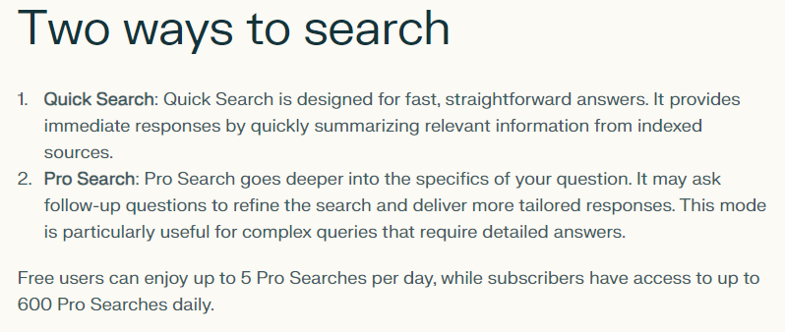

Slide 12
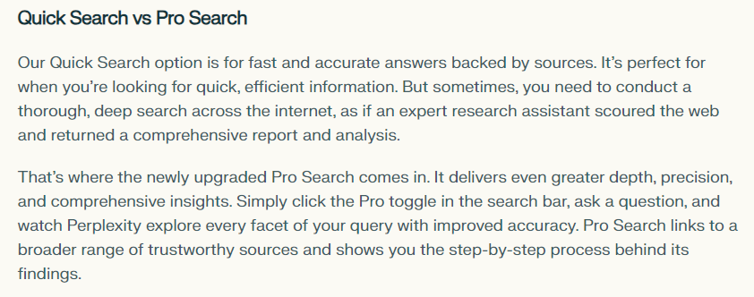
Notes:
https://www.perplexity.ai/hub/blog/pro-search-upgraded-for-more-advanced-problem-solving

Slide 13
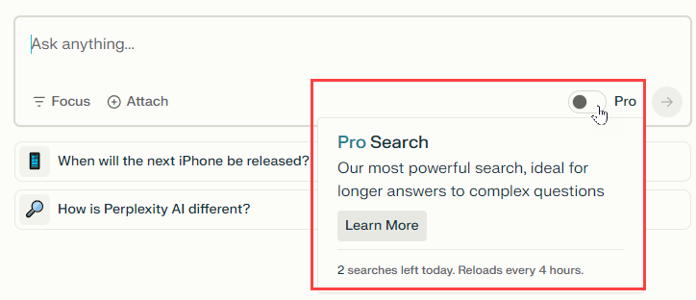

Slide 14
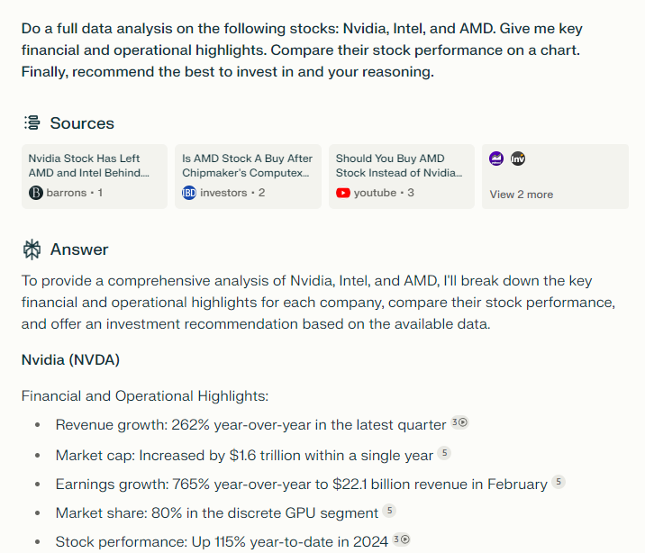
Quick search results
Notes:
Do a full data analysis on the following stocks: Nvidia, Intel, and AMD. Give me key financial and operational highlights. Compare their stock performance on a chart. Finally, recommend the best to invest in and your reasoning.

Slide 15
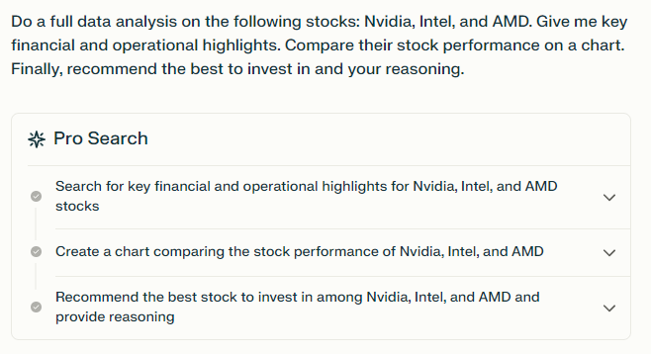
Pro search results

Slide 16
Pro Features

Slide 17
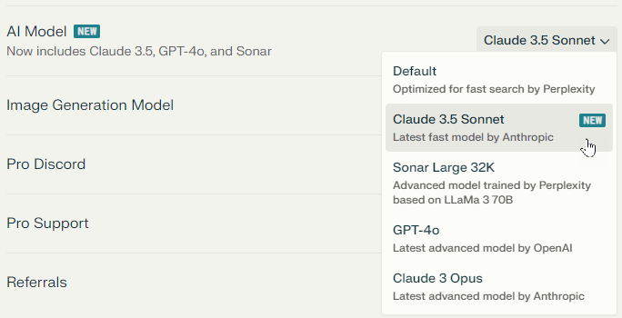
Notes:
https://www.perplexity.ai/settings/account

Slide 18
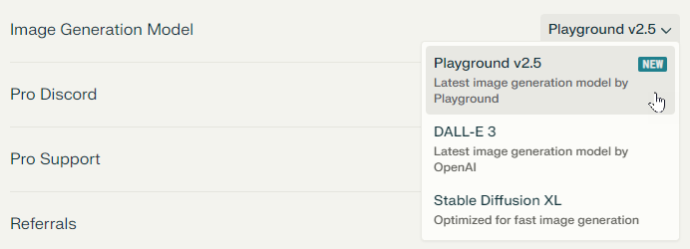
Notes:
https://www.perplexity.ai/settings/account

Slide 19
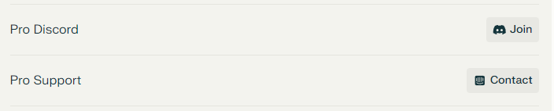
Notes:
https://www.perplexity.ai/settings/account

Slide 20
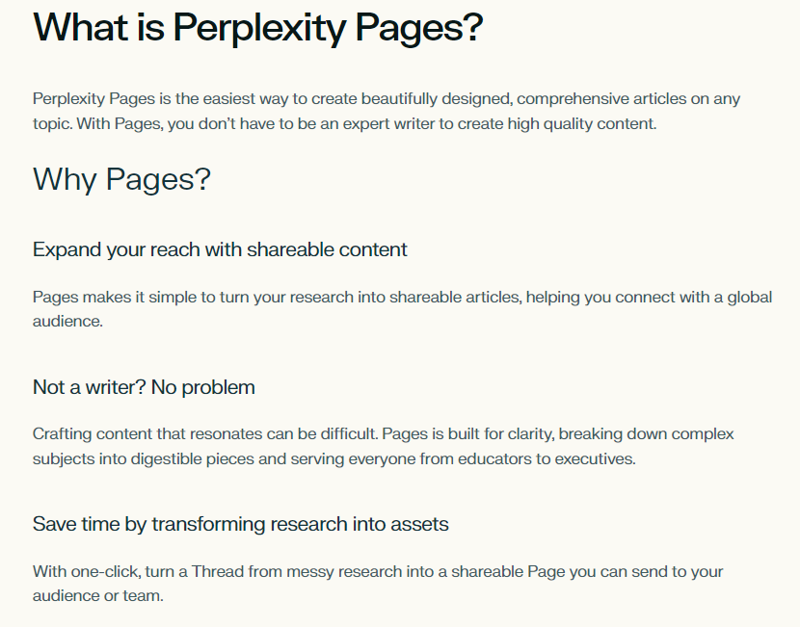
Notes:
https://www.perplexity.ai/hub/faq/what-is-perplexity-pages

Slide 21


